Slide 1
Write()
Sendto()
Recvfrom()
Write()
Read()
Sendto()
Recvfrom()
Write()
Sendto()
Recvfrom()
TCP전송방식
UDP전송방식

Slide 2
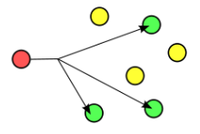

Multicast
Broadcast

Slide 3
Service Group part
Service n+2
Service n
….
Service n+1
Service n+3
….
….
….
….
X . X . X . X
X . X . X . X
X . X . X . X
X . X . X . X
X . X . X . X
X . X . X . X
Group 1
Group 2
Group 3

Slide 4
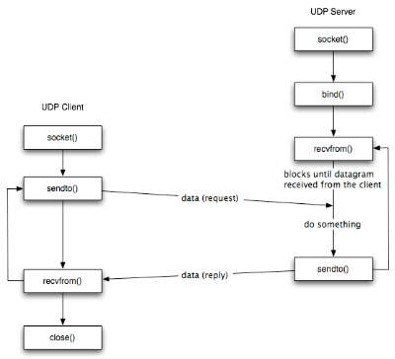
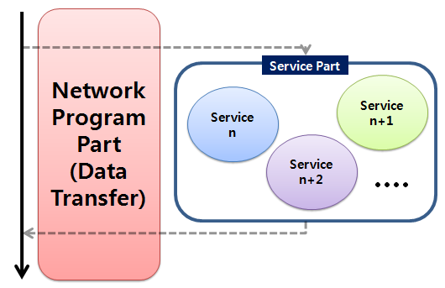

Slide 5
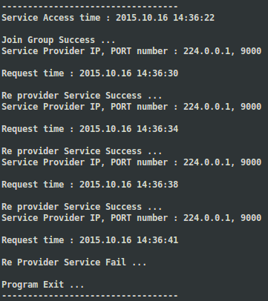
1
2
3
4

Slide 6
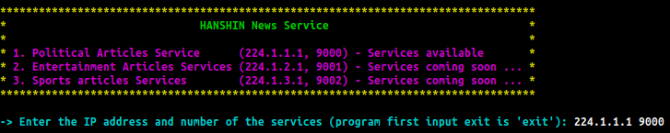
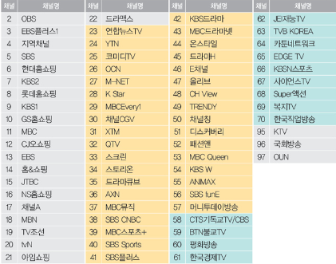

USER

